Slide 1


Introduction to Bioinformatics
Bioinformatics is an interdisciplinary field that combines biology, computer science, and mathematics to analyze and interpret biological data. It involves the development and application of computational tools to understand biological processes, from the molecular level to complex systems. This field plays a crucial role in modern biological research, enabling scientists to make sense of large datasets, understand genetic variations, and analyze biological sequences.
With the ever-growing volume of biological data, bioinformatics tools are essential for organizing, visualizing, and interpreting complex information. Bioinformatics has applications in genomics, proteomics, structural biology, and evolutionary biology. By leveraging computational techniques, researchers in bioinformatics contribute to diverse areas such as drug discovery, personalized medicine, and ecological modeling.

Slide 2
Interdisciplinary Nature
Understanding Bioinformatics
Data Management and Analysis
Bioinformatics is the interdisciplinary field that combines biology, computer science, and information technology. It involves the application of computational techniques to analyze and interpret biological data, ranging from DNA sequences to complex biological systems.
The scope of bioinformatics encompasses the management and analysis of large biological datasets, including genetic sequences, protein structures, and gene expression profiles. It aims to extract meaningful insights from these data to better understand biological processes and diseases.
Biological Databases and Tools
Integration with Biotechnology
Bioinformatics also involves the development and utilization of biological databases, algorithms, and software tools to support research in genomics, proteomics, and other life science disciplines. These resources are essential for storing, retrieving, and analyzing biological information.
The field of bioinformatics plays a crucial role in supporting advancements in biotechnology, personalized medicine, and precision agriculture. By harnessing the power of computational analysis, it enables the discovery of new drugs, the development of diagnostic tests, and the optimization of agricultural practices.

Slide 3

Applications in Genetics and Genomics
Genetics and genomics play a crucial role in various applications within the field of bioinformatics. In genetics, bioinformatics tools and techniques are extensively used in analyzing and interpreting genetic data, such as sequencing data, genomic variations, and hereditary diseases. These tools enable researchers to identify disease-causing genetic mutations, understand genetic predispositions, and track population genetics.
Additionally, in the realm of genomics, bioinformatics facilitates the study of whole genomes, including gene expression, structure, and function. It allows for the analysis of large-scale genomic data, such as genome sequencing, functional genomics, and comparative genomics, leading to groundbreaking discoveries in evolutionary genetics, disease mechanisms, and personalized medicine.
Furthermore, bioinformatics applications in genetics and genomics expand beyond research and academic settings, with far-reaching impacts on personalized healthcare, precision medicine, and the development of innovative therapeutic interventions tailored to individual genetic profiles.

Slide 4

Role in Drug Discovery and Development
1
Identifying Drug Targets
Bioinformatics plays a crucial role in drug discovery and development by aiding in the identification of potential drug targets. Through the analysis of biological data, such as genomics and proteomics, bioinformatics helps researchers pinpoint specific molecules or pathways that could be targeted by new drugs to treat diseases.
2
Virtual Screening and Drug Design
Using computational methods and algorithms, bioinformatics enables virtual screening of large compound libraries to identify potential drug candidates. Additionally, it assists in the design of new drugs by predicting their interactions with biological targets, which enhances the efficiency of the drug development process.
3
Pharmacogenomics and Personalized Medicine
Bioinformatics contributes to the field of pharmacogenomics, allowing for the customization of medical treatments based on an individual's genetic makeup. This personalized approach to medicine is revolutionizing drug discovery, as it enables the development of tailored therapeutics with improved efficacy and reduced adverse effects.

Slide 5
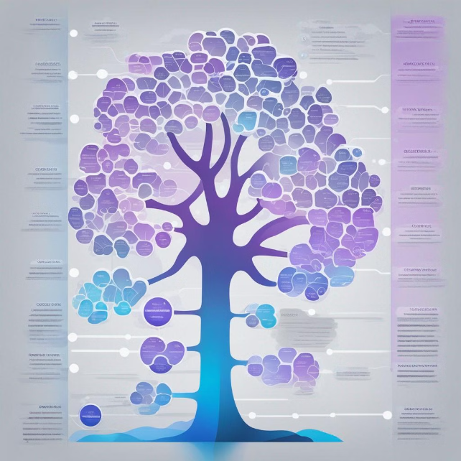
Use in Comparative Genomics
Comparative genomics is a crucial field within bioinformatics that involves the comparison of genomic sequences and structures across different species. By analyzing similarities and differences in the genetic makeup of organisms, researchers can gain valuable insights into evolutionary relationships, genetic variations, and functional elements within genomes.
One of the key aspects of comparative genomics is the identification of conserved regions and genes, which can provide important clues about the shared ancestry and evolutionary divergence of species. This information is essential for understanding genetic adaptations, diversification, and the emergence of unique traits.

Slide 6

Importance in Evolutionary Biology
Genetic Variation: Understanding the genetic diversity and variations in different species helps in tracing evolutionary patterns and relationships.
Molecular Evolution: Studying the molecular changes in DNA and proteins provides insights into evolutionary processes and timelines.
Phylogenetic Analysis: Utilizing bioinformatics tools to construct phylogenetic trees aids in understanding the evolutionary history of species and their common ancestors.

Slide 7



Bioinformatics Tools and Databases
Research Team
Data Visualization
Database Network
In the field of bioinformatics, dedicated research teams utilize advanced technologies to analyze vast DNA sequences. Their focused and intense work takes place in well-lit laboratory settings, where every detail matters in deciphering the genetic information encoded in the sequences.
Advanced bioinformatics tools enable the visualization of complex biological data on high-tech computer screens. The intricate details and vibrant colors offer researchers insights into the intricate patterns and structures within the genetic information, aiding in the discovery of key biological insights.
The bioinformatics community is interconnected through a global database network, represented by glowing nodes and connecting pathways. This network facilitates the exchange of genetic and genomic data, enabling researchers worldwide to collaborate and access valuable resources for their studies.

Slide 8
Challenges and Limitations
Data Management
Algorithm Complexity
Interdisciplinary Collaboration
Ethical and Legal Concerns
In bioinformatics, the massive amount of data generated from genomics, proteomics, and other omics studies presents a significant challenge in terms of storage, retrieval, and analysis. The need for efficient data management systems that can handle big data and ensure data integrity is a critical limitation in the field.
The development and implementation of complex algorithms for sequence alignment, protein structure prediction, and phylogenetic analysis often pose computational challenges. Balancing accuracy and speed in algorithm design is a persistent limitation in bioinformatics research and application.
The interdisciplinary nature of bioinformatics requires collaboration between biologists, computer scientists, statisticians, and other experts. However, differences in domain-specific jargon and methodologies can hinder effective communication and collaboration, posing a significant challenge in advancing bioinformatics research.
The ethical implications of genomic data privacy, consent, and accessibility present significant challenges. Balancing the advancement of bioinformatics research with ethical considerations and legal regulations surrounding genetic data is essential but complex, adding another layer of challenges to the field.

Slide 9
Future Trends in Bioinformatics
1
Integration of AI and Machine Learning
2
Precision Medicine and Personalized Genomics
One of the key future trends in bioinformatics is the integration of AI and machine learning algorithms to analyze large-scale biological data. This will enable the development of advanced predictive models and data-driven insights into complex biological processes.
Advancements in bioinformatics will lead to a greater emphasis on precision medicine and personalized genomics. This will involve the use of genetic and molecular information to tailor medical treatments and interventions to individual patients, optimizing healthcare outcomes.
3
Multi-Omics Integration
4
Ethical and Legal Implications
Future bioinformatics research will focus on the integration of multiple -omics data, including genomics, transcriptomics, proteomics, and metabolomics. This holistic approach will provide a more comprehensive understanding of biological systems and their interactions, leading to breakthroughs in disease research and therapy development.
As bioinformatics continues to advance, there will be a growing focus on the ethical and legal implications of utilizing genetic and health-related data. This will involve the development of robust governance frameworks and regulatory policies to ensure responsible and fair use of sensitive biological information.

Slide 10
Conclusion and Summary
Bioinformatics is an ever-evolving field that plays a critical role in advancing various scientific and medical disciplines. With its applications in genetics, genomics, drug discovery, and comparative genomics, bioinformatics has proven to be indispensable in understanding the complexities of biological systems. The comprehensive analysis and interpretation of biological data have contributed significantly to the progress of evolutionary biology, unlocking new insights into the mechanisms of life.
By harnessing cutting-edge tools and databases, bioinformatics enables researchers to elucidate intricate biological phenomena and uncover hidden patterns within vast datasets. However, despite its invaluable contributions, bioinformatics also faces challenges and limitations, including data quality issues and the need for enhanced computational infrastructure.
In summary, bioinformatics stands at the forefront of scientific innovation, driving groundbreaking discoveries and paving the way for a deeper understanding of life's fundamental processes. Its interdisciplinary nature and impactful applications position bioinformatics as a cornerstone of modern biological research, with boundless potential for future exploration and discovery.

